Slide 1

Shell Command Executor in C
Group Members:
Abubakar Waziri - 4220056
Muhammad Alansari - 4312897

Slide 2

Overview
Implemented a shell command executor in C with features including:
Command execution.
Command history management.
Simultaneous execution of commands using the join() command.

Slide 3
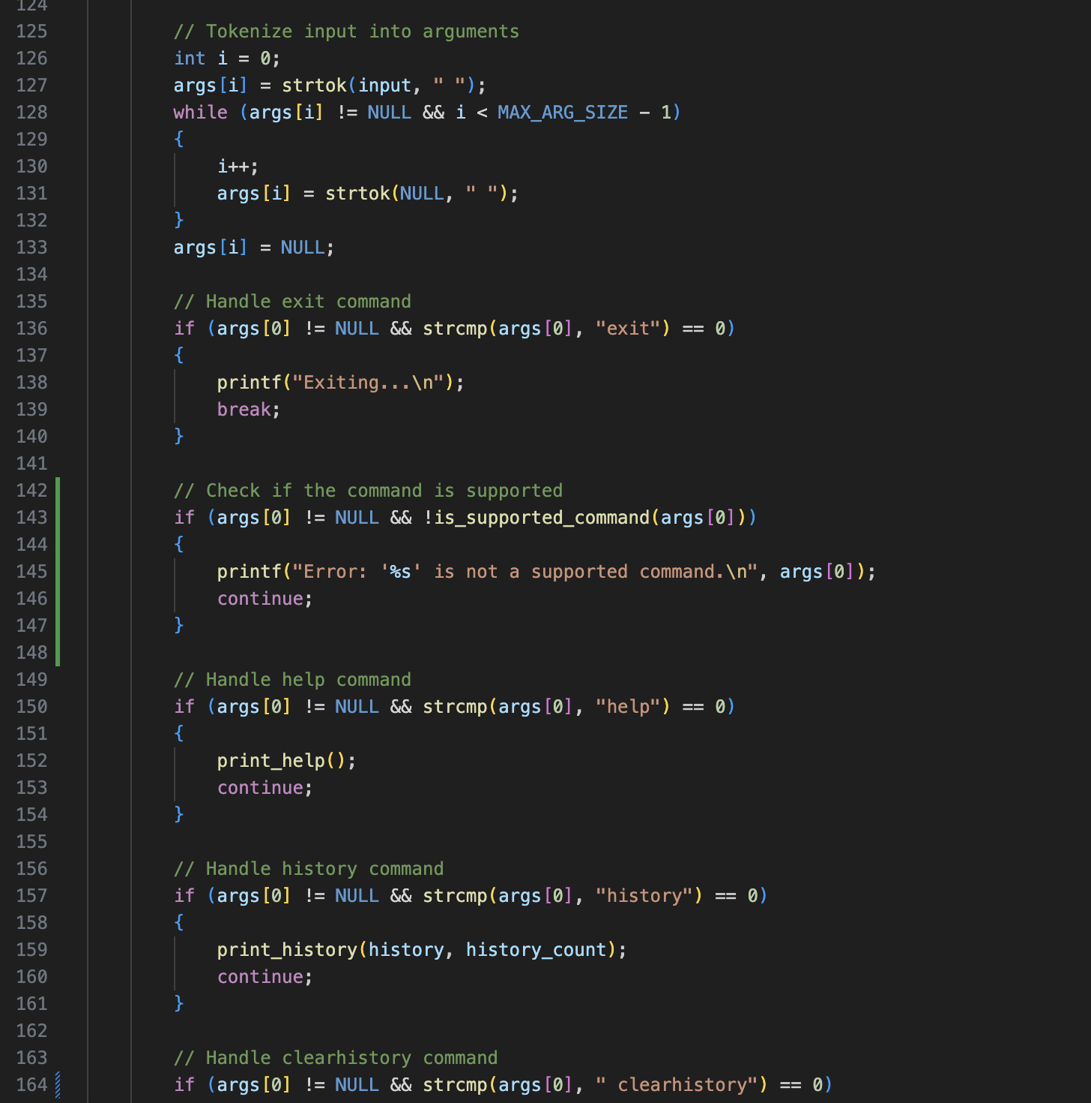
Key Features
Command Execution: Run shell commands such as ls, pwd, whoami.
Command History: Maintain and display the last 100 commands.
Join Command: Execute two commands concurrently.
Thread Safety: Protect command history using a mutex.

Slide 4
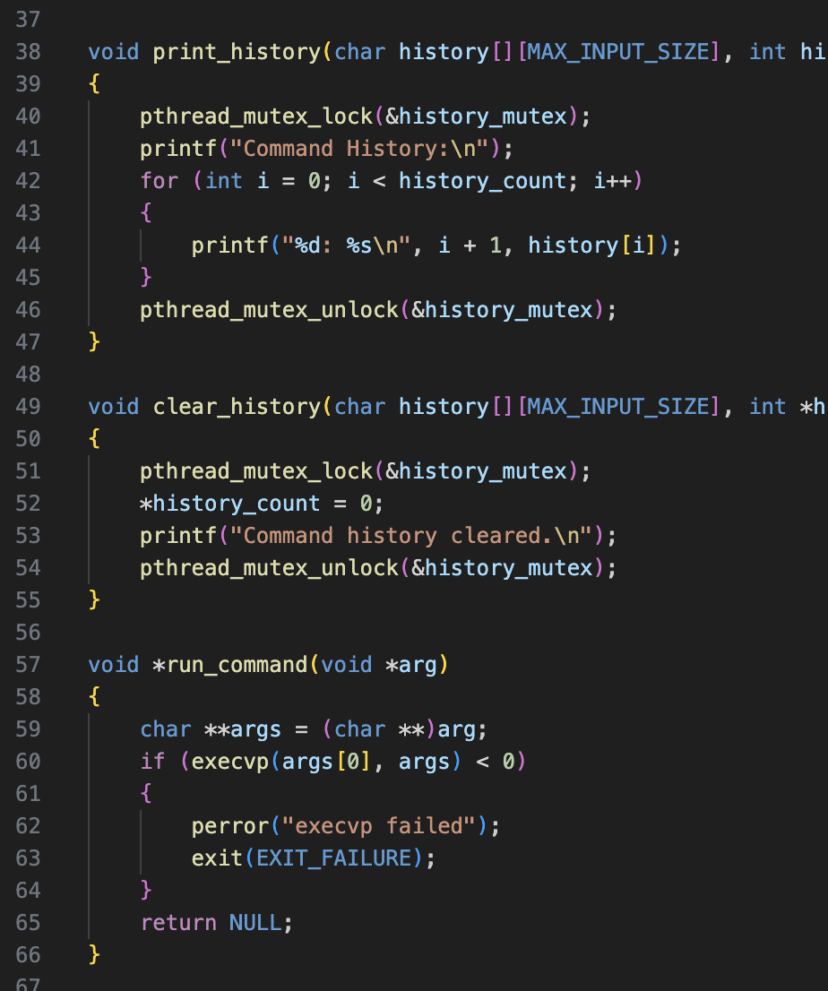
Command Execution
Core Function: run_command()
Executes commands using execvp().
Forks a new process for each command.
Handles errors if command execution fails.

Slide 5
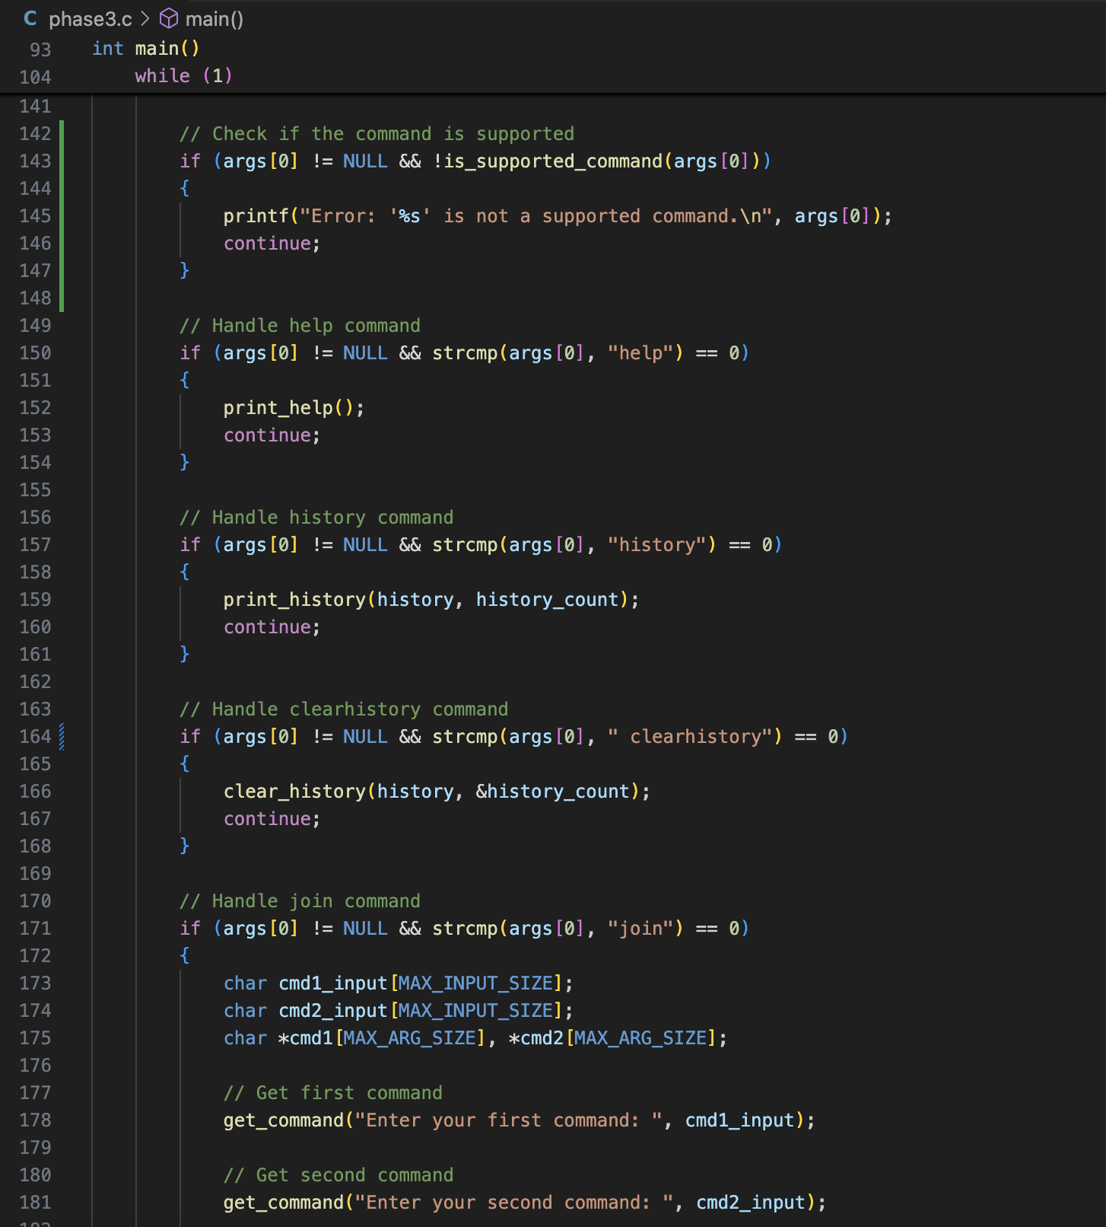
Command History Management
History Storage: Keeps a record of the last 100 commands.
Mutex Protection: Ensures thread safety for concurrent access.
Functions: print_history(): Displays command history. And clear_history(): Clears stored history.
Resource Cleanup: pthread_mutex_destroy(&history_mutex); frees mutex resources when no longer needed.

Slide 6
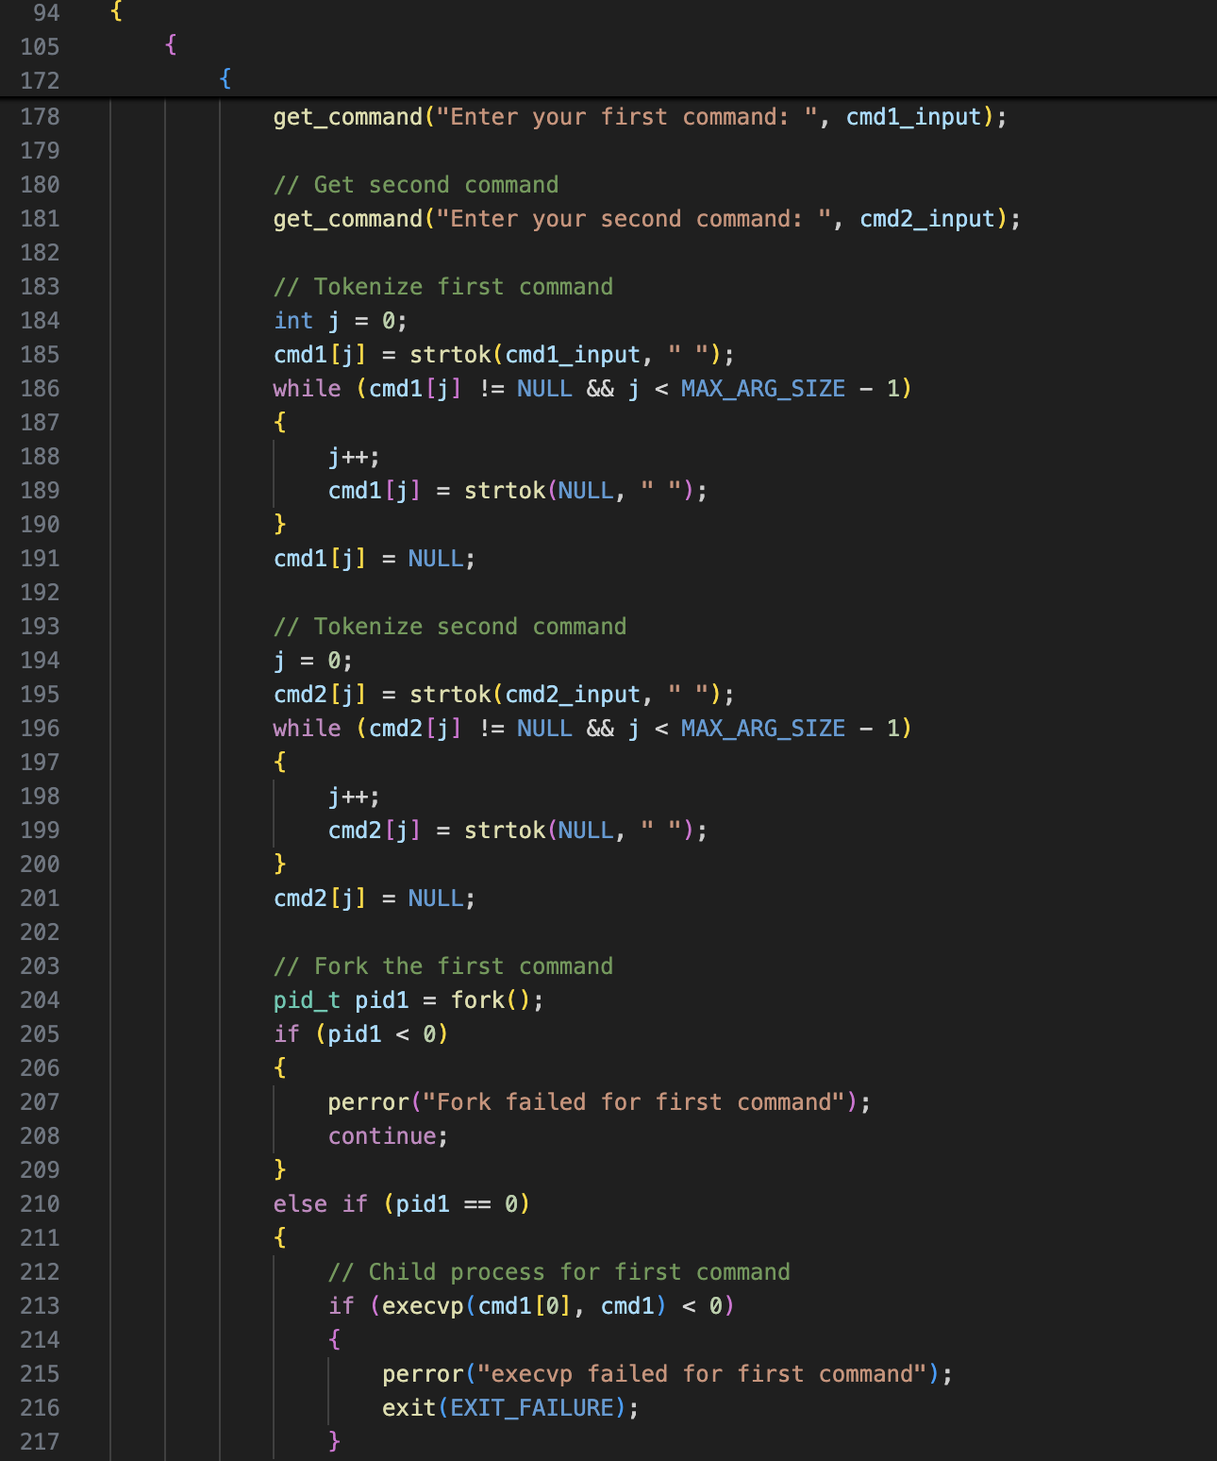
Join Command Implementation
What It Does:
Allows users to execute two commands simultaneously.
Implementation Steps:
Condition Check:
Verify the first argument is join.
Input Commands:
Use get_command() to capture two commands.
Tokenization:
Split commands into tokens using strtok(). And Prepare arguments for execvp().
Fork Processes:
Create two child processes using fork(). And Each process runs one command with execvp().
Parent Process Wait:
Wait for both processes to complete using waitpid().

Slide 7
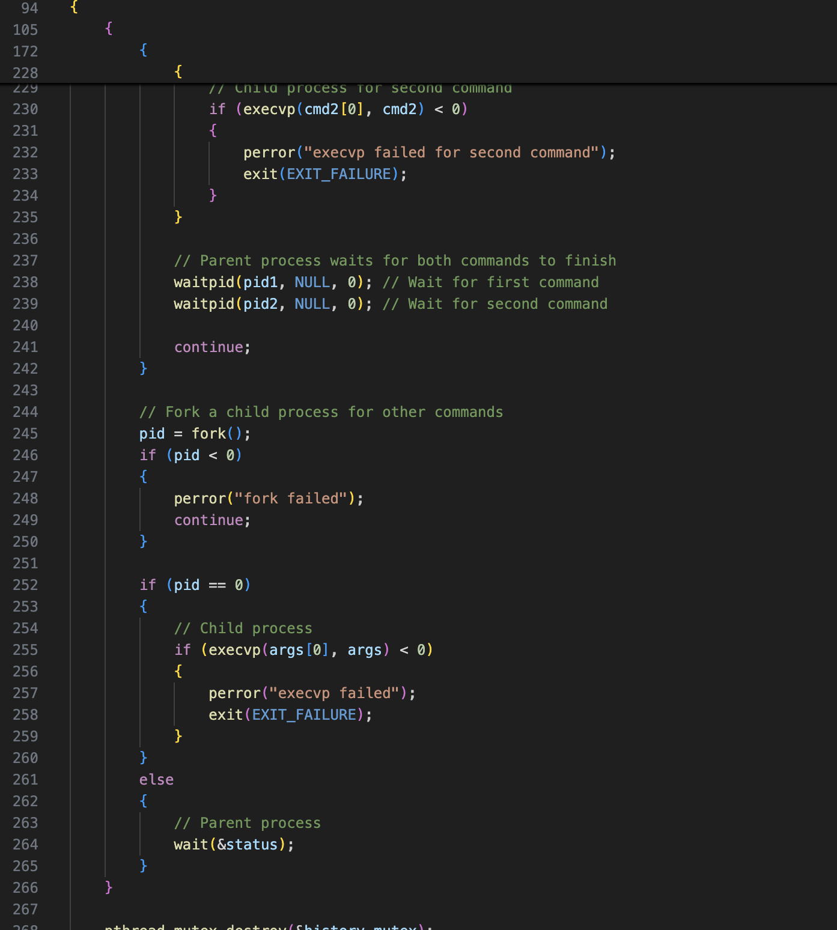
Threading and Process Control
Thread Safety:
Mutex (pthread_mutex_t) ensures safe access to shared data.
Process Management:
fork() creates new processes.
execvp() executes commands.
wait() and waitpid() synchronize processes.

Slide 8
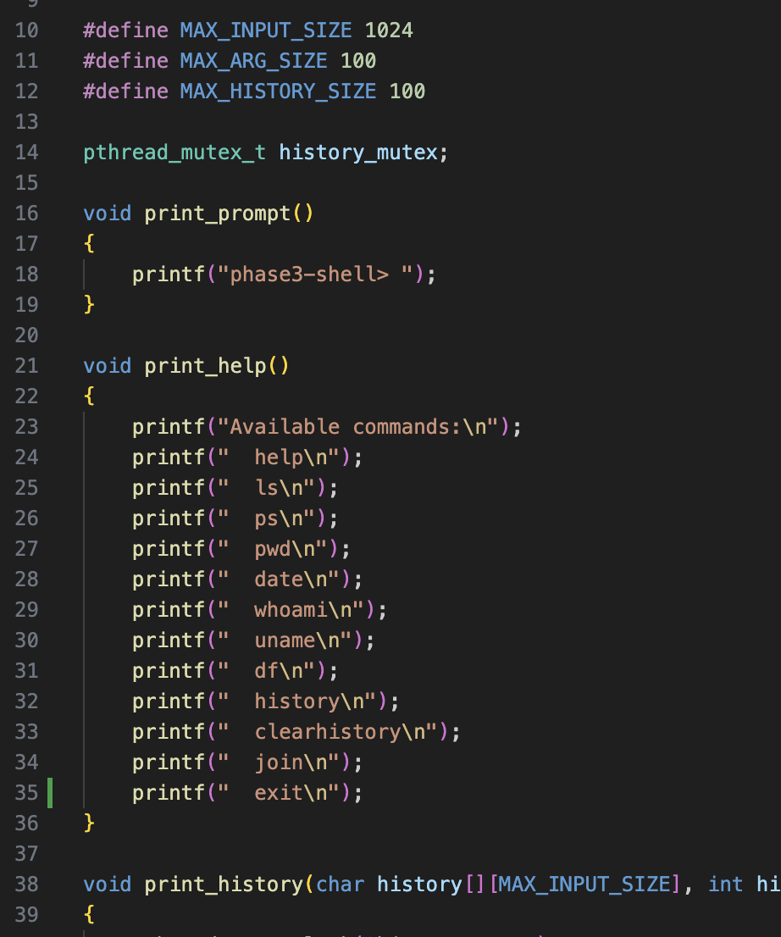
Key Functions
Core Functions:
print_prompt(): Displays the shell prompt.
get_command(): Reads user input.
run_command(): Executes a command in a child process.
Utility Functions:
is_supported_command(): Verifies if a command is supported.
print_help(): Lists available commands.

Slide 9
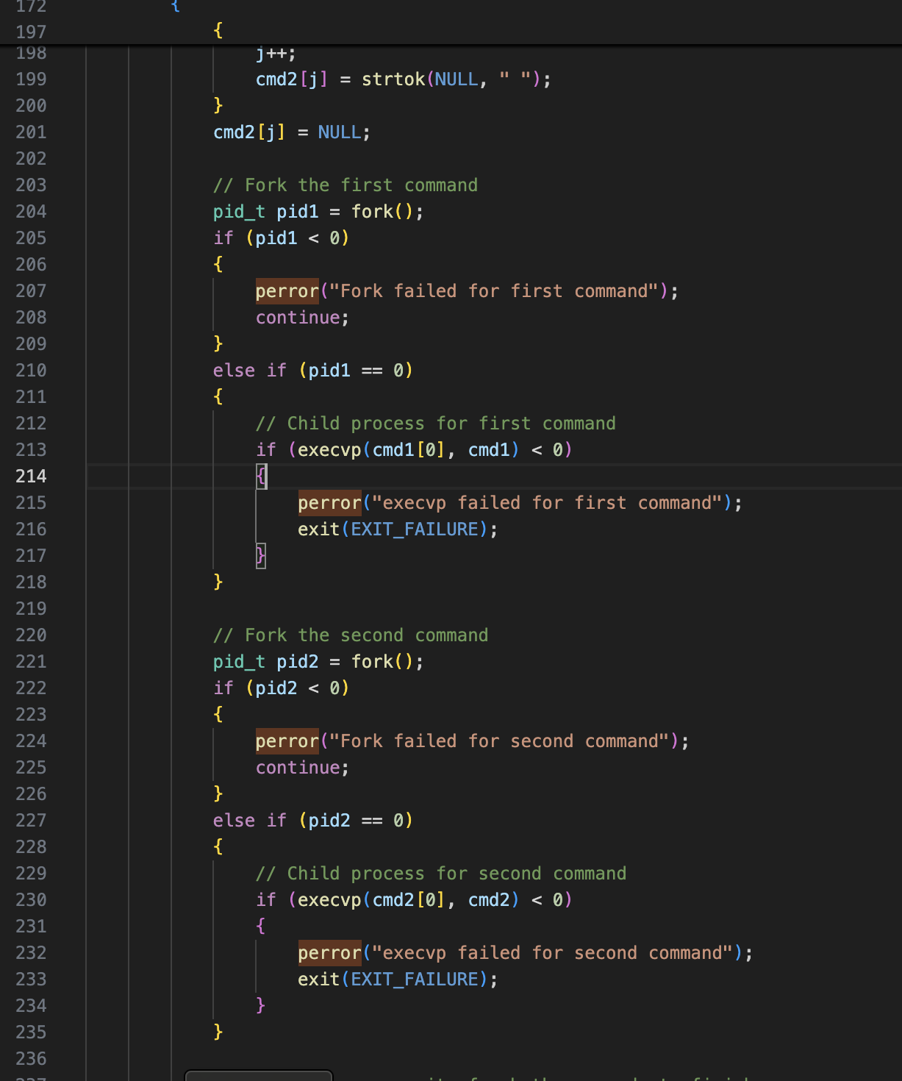
Error Handling
Common Errors Managed:
Invalid commands or unsupported operations.
Failure during forking or command execution.
Error Messages:
Inform users of issues like unsupported commands or execution failures using perror().

Slide 10
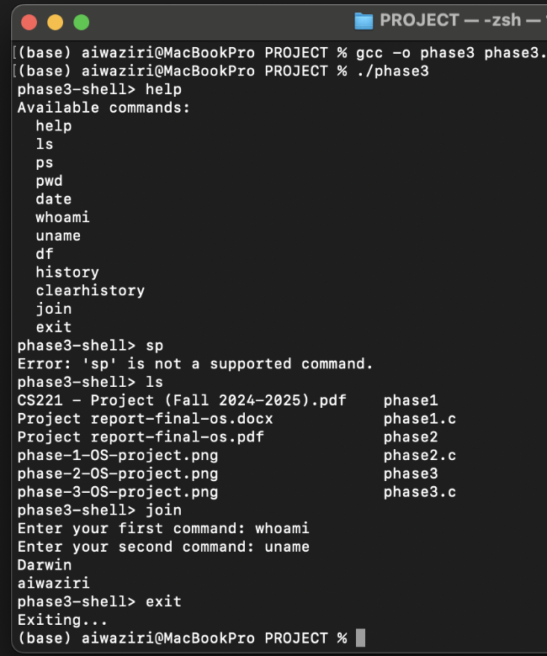
Discussion on Results
Successfully implemented and tested the shell command executor.
Results:
Executed multiple commands, maintained history without errors.
Verified join command for concurrent execution of commands.

Slide 11
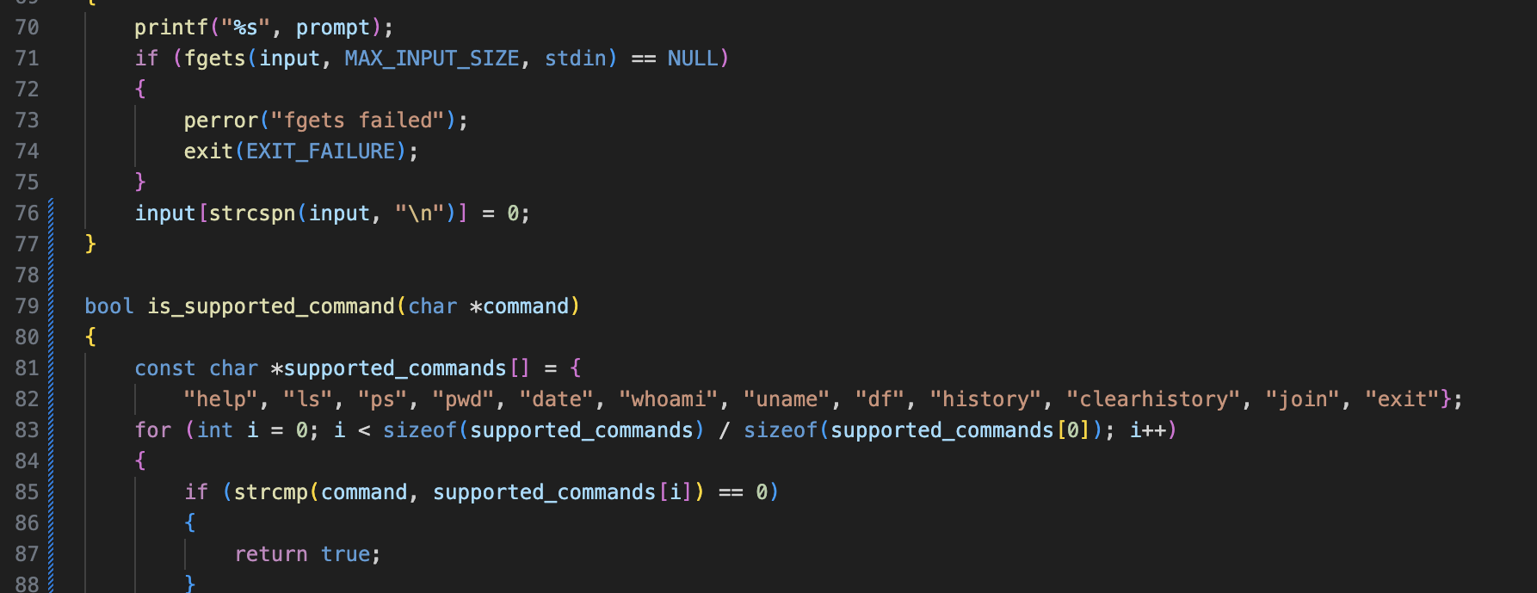
Key Changes in the Updated Version
Added is_supported_command() to verify commands before execution.
Improved error handling for unsupported commands.

Slide 12
Conclusion
Achievements:
• Implemented a functional shell command executor.
• Supported key features: history, threading, and concurrent execution.
Future Improvements:
• Add more built-in commands.
• Enhance error handling and input validation.
• Improve user interface for better usability.

Slide 13
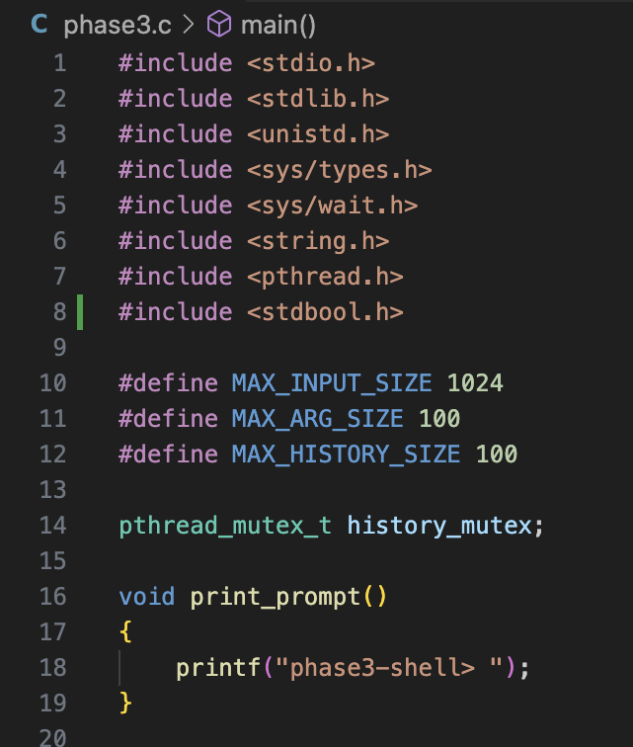
Keywords and Terminology
Key Headers: stdio.h, stdlib.h, unistd.h, etc.
Threading: pthread_mutex_t and mutex operations.
Process Control: fork(), execvp(), waitpid().
Error Handling: perror(), exit(EXIT_FAILURE).
Shell Commands: help, ls, history, join, exit. etc

Slide 14

Questions & Answers

